Slide 1
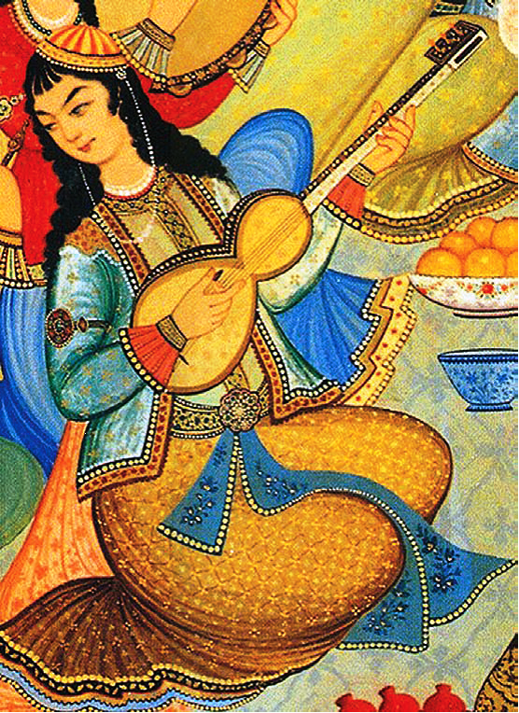
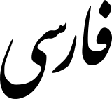
Persian
Language in 10 Minutes Series
Nizar Habash
Notes:
For each language, the student will prepare three slides: (1) Language Facts (demographics, location, etc.) (2) Important linguistic characteristics (orthography, morphology, syntax) and (3) computational efforts such as resources, tools, papers -- e.g., how many entries in MT Archive? and what are they generally on?

Slide 2
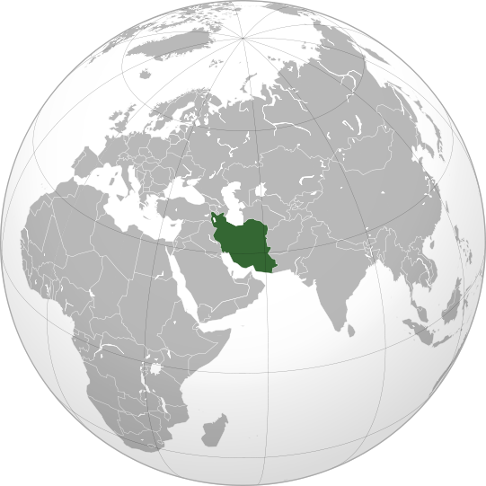
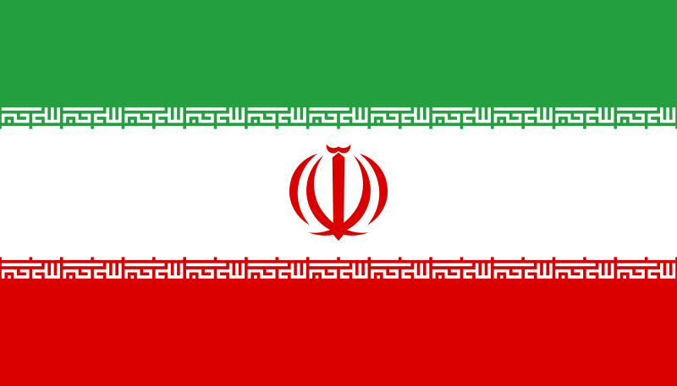
What/Where/When/Who
Farsi and Dari are Written in Arabic script
Persian is the official language of Iran.
  Farsi, Parsi (Iranian Persian)
  Dari (Afghan Persian)
  Tajiki (Tajik and Uzbek Persian)
Persian is spoken in Arab Persian Gulf countries (Iraq, Bahrain, Kuwait, UAE) and in Pakistan.
Total native speakers ≈ 70M
Modern Persian is about 1,200 years old
  Old Persian goes back to 500 BC
Tajiki is Written in Cyrillic script

Slide 3
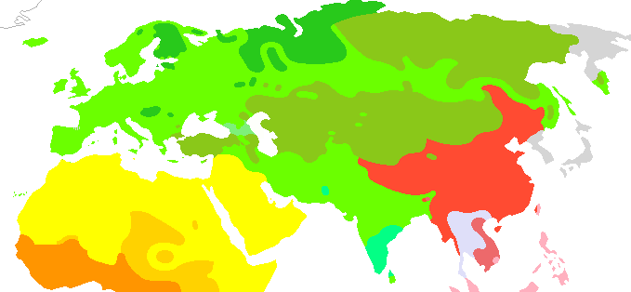
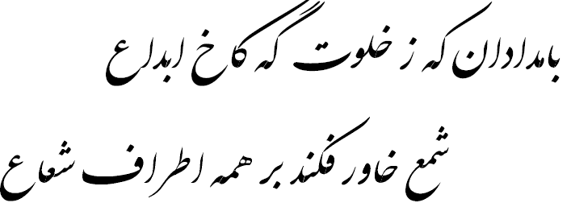
Interesting Linguistic Facts
Persian is an Indo-European language
  A relative of English and not of Arabic
Persian is written in Arabic script and has numerous borrowings from Arabic
English/`arabi
Brother/akh | Daughter/bint | Father/ab | Cow/baqara | God/Allah | Mouse/fa:r
birâdar | dukhtar | Pedar | Gâw | Khodâ | Mush
برادر | دختر | پدر | گاو | خدا | موش‌
farsi
In the morn from the privacy of the Palace of Creation The Eastern Candle emanates in every direction;
Hafiz

Slide 4
Interesting Linguistic Facts
Orthography is very ambiguous
  Short vowels are optional
    kerm worm, karam generosity,
    kerem cream, krom chrome, karm vine (Amtrup et al., 2000)
Morphology
  A mix of Affixational and Templatic
    ketâb book → kotob or ketâbha books
  Verbs express tense and aspect, and agree with subject in person and number.
  There is no grammatical gender in Persian.
krm كرم‌
Amtrup et al., 2000. Persian-English Machine Translation: An Overview of the Shiraz Project.

Slide 5
Interesting Linguistic Facts
Syntax (Amtrup et al., 2000.)
  Sentence: Subject-Object-Verb
    Specific objects are followed by an object marker râ
  bache-hâ panjare râ shekast-and
  children window Obj broke-they
  ‘The children broke the window.’
  Light Verb Construction
    Simple verbs in Persian are rare and dying out!
zendegi kardan | Life do | to live
gul zadan | Deception hit | To deceive
klik kardan | Click do | To click
email zadan | Email hit | To email
Amtrup et al., 2000. Persian-English Machine Translation: An Overview of the Shiraz Project.
http://lingweb.eva.mpg.de/fieldtools/pdf/PersianGrammarSketch.pdf

Slide 6
Interesting Linguistic Facts
Syntax (Amtrup et al., 2000.)
  Noun Phrase: Determiner specifier head modifier
    Ezafe construction: -e
    Noun Ezafe Modifier:
        in do tâ ketâb-e kohne
        this two CL book-e old `These two old books’
    Possessed Ezafe Possessor
    ketâb-e pedar-e dâryush
    book-e father-e Dariush `the book of Dariush’s father’
Amtrup et al., 2000. Persian-English Machine Translation: An Overview of the Shiraz Project.
http://lingweb.eva.mpg.de/fieldtools/pdf/PersianGrammarSketch.pdf

Slide 7
Computational Efforts
Growing number of papers on Persian computational linguistics
Persian Morphology (Arabsorkhi & Shamsfard, 2006; Sharifloo & Shamsfard, 2008)
Persian Speech Recognition (Srinivasamurthy and Narayanan, 2003)
Rule Based MT
  Shiraz: Persian-English rule-based MT (Amtrup et al., 2000; Zajac et al., 2000)
  PEnTrans: Persian <> English rule-based MT (Saedi et al., 2009)
Statistical MT
  Transonics: Speech-to-Speech MT for English<>Farsi Medical Dialogues (Narayanan, 2003; Ettelaie et al., 2005) [DARPA Babylon project]
  Google Translate
Resources
  3.5M word parallel Persian-English corpus (ELRA), Shiraz corpus (50K words);
  Good MT resource background paper: Mohaghegh et al. (2010, SSST)
Online paper collections
  Society of Iranian Linguistics (entries on linguistics and computational linguistics)
  ACL Anthology (few papers); MT archive (~20 papers)

Slide 8
ممنون
Mamnoon
Thank you

